Slide 1
Technology Projects
High Failure Rate
Is it the technology?
If not, what is it?
Notes:
Started as programmer
experienced project cancellation
along with pressure from backlog
Dept of Army study - less than 5% projects:
on time, within budget, meeting all requirements
Involved with CASE & methods
thought technology could provide answer
Got involved with project management as concluded that organizational behavior was the culprit, not the technology

Slide 2
Topics
Is there a problem? What evidence do we have?
What are the problem symptoms?
What are the success factors?
What does it all mean?

Slide 3
The Evidence
Standish Group International
  Survey had 365 respondents
  Representing 8,380 applications
  Covering all major industry segments
  Reported in Application Development Trends, Jan. 1995
  “Chaos: The Dollar Drain Of IT Project Failures”
Notes:
Chaos: The Dollar Drain Of IT Project Failures
Application Development Trends, January 1995
by Jim Johnson, Standish Group

Slide 4

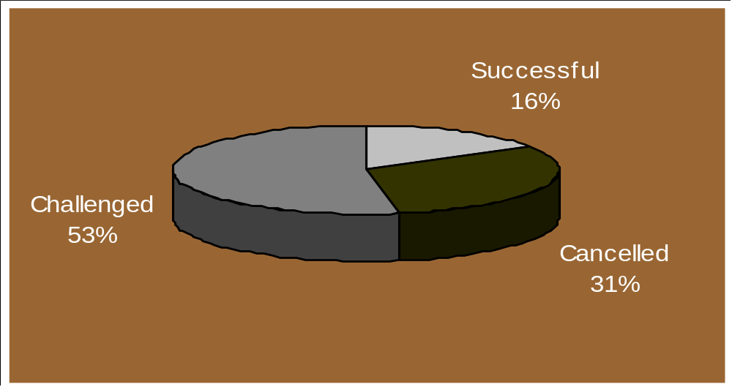
Project Success/Failure Ratios
Notes:
Successful 16% 1360
Cancelled 31% 2604
Challenged 53% 4416
____
8380
84% late, over budget, or lacking features
Success: on time, within budget,
meeting all requirements
Challenged: completed, but over budget,
late, and with less features
Cancelled: not completed

Slide 5
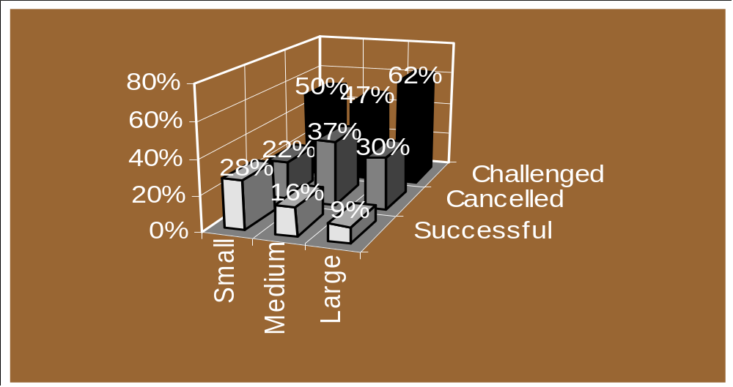
Project Success/Failure Ratios
Notes:
Small Medium Large
Successful 28% 16% 9%
Cancelled 22% 37% 30%
Challenged 50% 47% 62%
____ ____ ____
100% 100% 100%
Projects late, over budget, lacking features:
Small 72%
Medium 84%
Large 91%

Slide 6
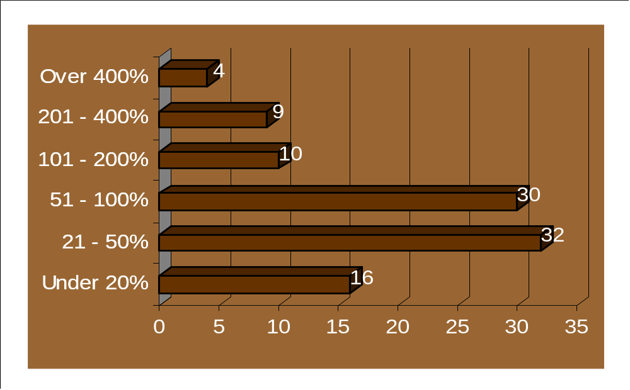
Cost Overruns for Challenged and Cancelled Projects
Notes:
For all companies, combined cancelled and challenged projects:
Cost Overrun Average is 189%
Average of all projects by company size:
Small 114% (worst)
Medium 82%
Large 78% (best?)

Slide 7
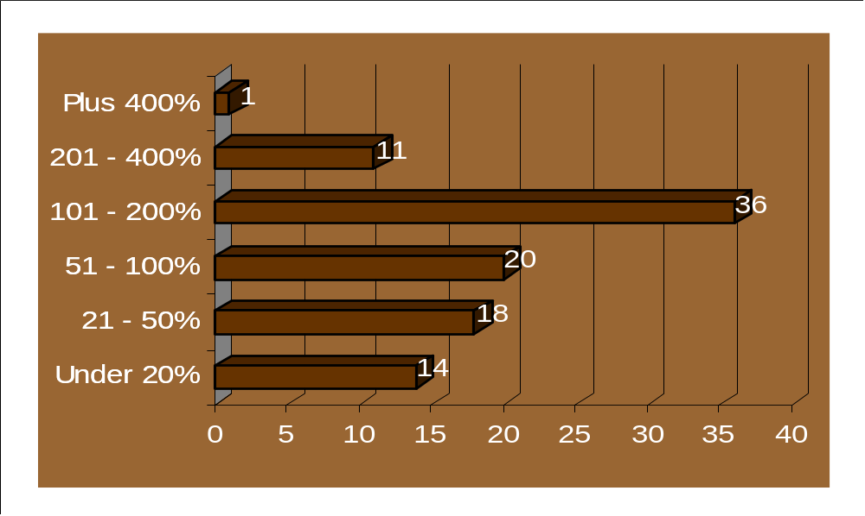
Time Overruns for Challenged and Cancelled Projects
Notes:
For all companies, combined cancelled and challenged projects:
Average time overrun 222%
For all projects by company size:
Small 139%
Medium 102%
Large 139%

Slide 8
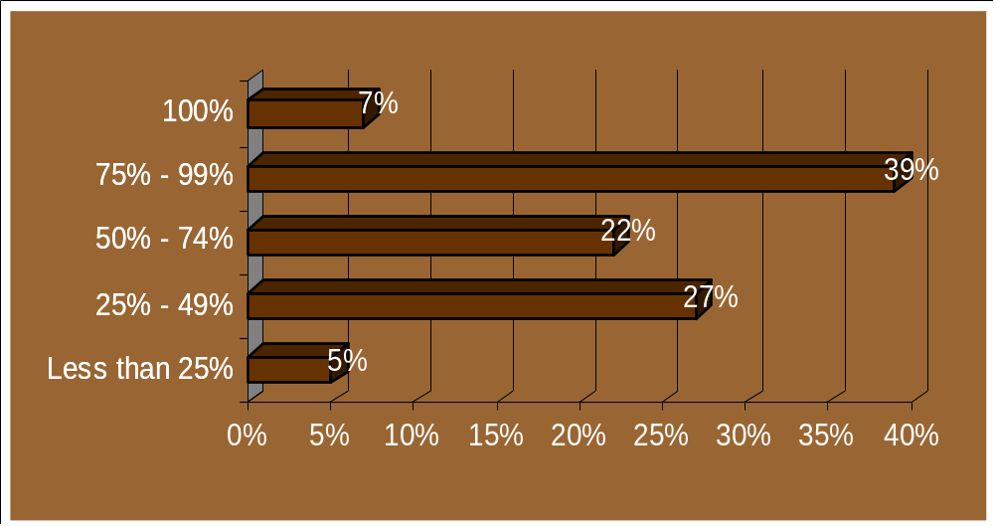
Percentage of Achieved Features in Challenged Projects
Notes:
More than a quarter of challenged projects were completed with only 25% to 49% of originally specified features and functions.
On average, only 61% of originally specified features and functions were available on these projects.

Slide 9
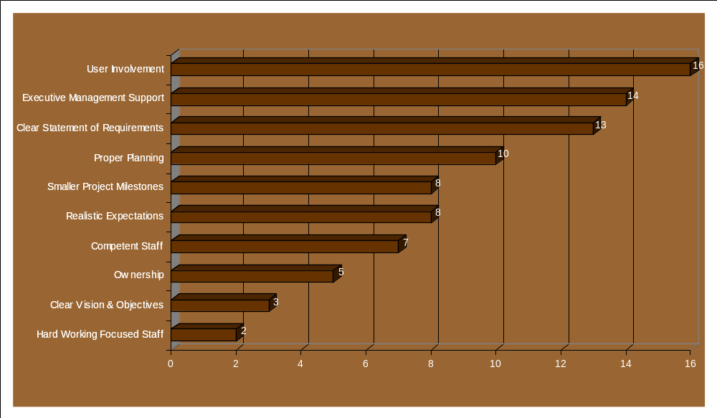
Why Projects Succeed
Notes:
By percent of responses
According to many IT managers, a hardworking staff is not nearly as important as user involvement in project success.
3 primary reasons project succeed:
- user involvement
- management support
- clear requirements

Slide 10
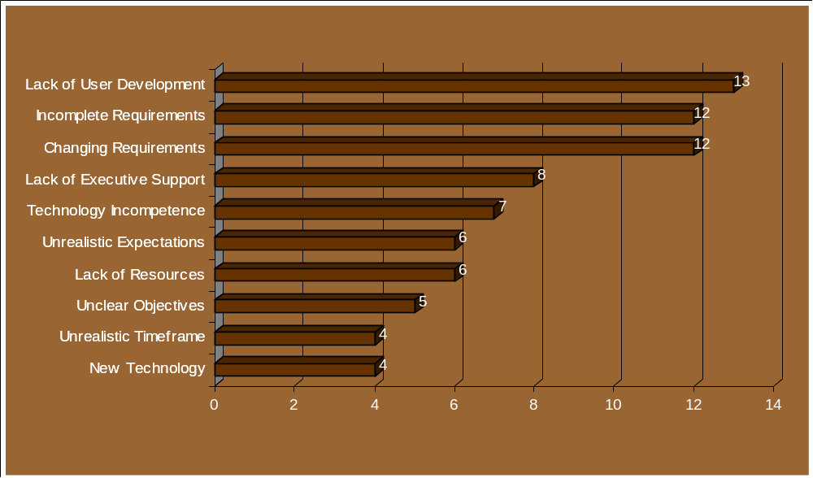
Why Projects Are Challenged
Notes:
By percent of responses
Incomplete and changing requirements greatly contribute to a project becoming challenged.

Slide 11
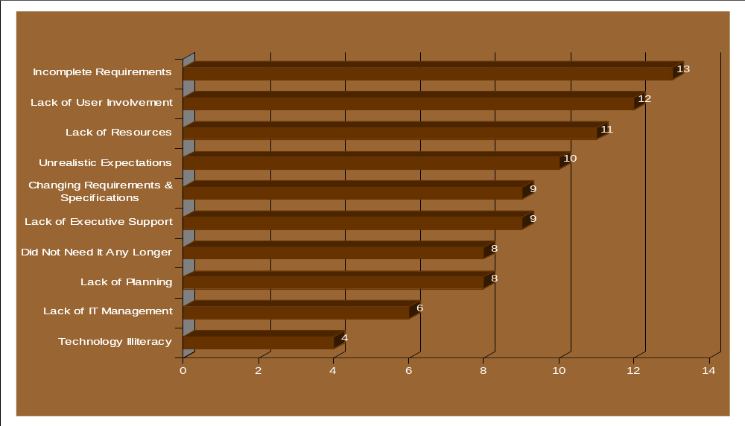
Why Projects Are Cancelled
Notes:
By percent of responses
Combined lack of resources and unrealistic expectations loom large in project failure.

Slide 12
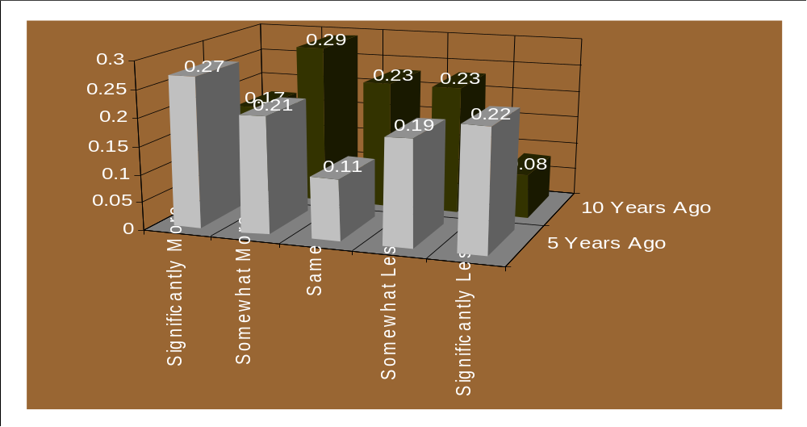
Executive Perception of Project Failure Today vs. Yesterday
Notes:
Opinions vary about whether failure rates have increased or decreased.
but 25% believe project success is significantly worse than before -
is your manager one of them?
what does this do to your credibility?
could this be a reason your advice is ignored?

Slide 13
IT Executives View of
Four Projects
Notes:
Chaos: The Dollar Drain Of IT Project Failures
Application Development Trends, January 1995
by Jim Johnson, Chairman, Standish Group
Success Points = weighting factor
The DMV project had virtually no chance of success,
while Hyatt’s reservation project had all the right ingredients.

Slide 14
Requirements
The Dilbert Principle
At some point in the project somebody will start whining about the need to determine the project “requirements”.
This involves interviewing people who don’t know what they want but, curiously, know exactly when they need it.
These people are called “end users”, or simply “pinheads”.
Research has shown that there is nothing on this planet dumber than an “end user”.
Notes:
The Dilbert Principle
Requirements, pg 231
Research documented in The Dilbert Principle identifies “end user” intelligence at 50% that of a hammer and 1/20th that of a cat.
I wonder if that’s why project managers often muse about “hearding cats”, perhaps that is an optimistic vision of team leadership?

Slide 15
Symptoms of Failure
Project Management Journal, Sept. 1997
Computerworld, October 6, 1997
PM Network, November 1996
CIO, October 15, 1997
Crosstalk, November 1996
Itxpo 97 Conference
Managing the Software Process, 1990
Business Week, Sept. 29 1997
Notes:
Articles and book

Slide 16
8 Project Management Policies
Project Management Journal, Sept. 1997
Notes:
Better Policies Provide the Key to Implementing Project Management
Project Management Journal, September 1997
Survey of 280 people who work on product development, information systems, research and capital projects.
Result: “… in order to have long-term productivity payoffs, organizations should focus on the top-down apporach of implementing project-oriented policies before the bottom-up approach of training and procedures.”

Slide 17
Why Projects Fail
Computerworld, October 6, 1997
Mistaking half-baked ideas for viable projects
Dictating unrealistic project deadlines
Assigning underskilled project managers to highly complex projects
Not providing solid business sponsorship
Failing to break projects into chunks
Failing to institute a robust project process
Not factoring in the competing demands of other projects
Notes:
Computerworld, October 6, 1997
“Managing: Captain of Crunch” by Rochelle Garner
“Management’s Seven Deadly Sins - Why Projects Fail”
Gopal Kapur, Center For Project Management

Slide 18
12 Reasons Why Programs Fail
PM Network, November 1996
Underestimating Program Complexity
Lack of Access and Internal Communication
Not Integrating Key Elements: Cost and Configuration Control
No Measurable Controls
Requirements Creep
Ineffective Implementation Strategy
A Software Tool is Not the Only Answer
Differing Expectations
No Shared Win-Win Attitude
No Formal Education\
Lack of Leadership Commitment and Sponsorship
Not Viewed as a Start up Business
Notes:
Twelve Reasons Why Programs Fail, by John Gioia
PM Network, November 1996
“Large, high-profile programs either quietly succeed or fail spectacularly. The difference between success and failure can be traced to a dozen basic causes.”
“While there are essentially 12 principle reasons why programs fail, it only takes one of them to make the difference between success and failure.”
John Gioia, CEO, Robbins-Gioia

Slide 19
When Bad Things Happen to Good Projects
CIO, October 15, 1997
Project managers don't understand user's needs
Scope is ill-defined
Project changes are managed poorly
Chosen technology changes
Business needs change
Deadlines are unrealistic
Users are resistant
Sponsorship is lost
Project lacks people with appropriate skills
Best practices and lessons learned are ignored
Notes:
When Bad Things Happen To Good Projects
CIO, October 15, 1997
“Lost along the way: 10 signs of IS project failure.”
How to spot impending doom:
benchmark goals aren’t met
unresolved issues outnumber deliverables
communication breaks down
project costs escalate
When to call it quits:
When costs exceed business benefits
When deadlines continue to be missed
When technology or business needs evolve beyond projects scope

Slide 20
The Capability Im-Maturity Model (CIMM)
Crosstalk, November 1996
0. Negligent
  Characterized by Indifference
-1. Obstructive
  Characterized by counter-productive behavior
-2 Contemptuous
  Characterized by arrogance
-3 Undermining
  Characterized by sabotage
Notes:
Capability Im-Maturity Model (CIMM)
Crosstalk, November 1996
Level 5 - Optimizing - Continuous Improvement
Level 4 - Managed - Predictable
Level 3 - Defined - Standard & Consistent
Level 2 - Repeatable - Intuitive
Level 1 - Initial - Ad hoc & chaotic
“According to SEI data, more than 70% of all software organizations are at Level 1. This information is extremely misleading. In actuality, many organizations lie well below the merely chaotic.”

Slide 21
Gartner Warns of 75% Failure Rate for Enterprise Mgmt Projects
Itxpo 97 Conference
Shift from technology to business focus
Break down walls between specialists:
  It isn’t your problem, it’s our problem.
Plan strategically
Implement tactically
Keep deadlines short
Involve field engineers

Slide 22
Why Software Organizations are Chaotic
Under extreme pressure, managers make a guess rather than a plan.
When going gets rough, strong temptation to believe in magic.
Software projects follow an escalating cycle.
Organizations will revert to their initial practices when placed under pressure.
Notes:
Managing the Software Process, 1990
Watts Humphrey
These are the behaviors we have all experienced.
no time to effectively plan
belief that “it will work out, just do it”
reality is that it gets worse
even an organization with processes will be tempted to abandon them

Slide 23
XEROX Won’t Duplicate Past Errors
Business Week, Sept. 29 1997
by 1979 had it all:
  graphical user interfaces
  mouse
  windows & pull-down menus
  laser printers
  distributed computing
  ethernet
Notes:
didn’t patent any of the technology
“Management was too pre-occupied with aggressive competition in its core copier business” - CEO Paul A. Allaire
Steven Jobs visited PARC in 1979 and was astonished by what he saw, his tour inspired the Mac
Robert Metcalfe (ethernet inventor) left PARC to start 3Com
Giveaway days are over:
- Xerox now uses technology or funds spin-offs
- it took them 20 years to learn lesson

Slide 24
Management Support
The Dilbert Principle
No project can succeed without mgmt support.
The best sort of management support is the kind in which management doesn’t find out about the project until it’s a market success.
If management notices a project too soon, it’ll support it in the following ways:
  Demand frequent status reports to explain why the team doesn’t have enough time to meet deadlines.
  Demand explanations of how the project is different from all the projects that have similar acronyms.
  Ask the team what it could do if it had only half as much funding.
  Appoint an oversight committee whose members are always on trips.
Notes:
The Dilbert Principle
Management Support, pg 233
To put it another way, managers understand that their role is to remove obstacles from the project team.
They could probably do that, with the help of Dr. Kevorkian,
but most managers aren’t such good sports.
Therefore, coincidentally, the biggest obstacle to the success of any project is management itself.

Slide 25
Symptoms of Success
Datamation, November, 1997
Project Management Journal, June 1994
Gartner Group Reports
Managing Software Development Projects, 1990
Crosstalk, Jan. 1997
Crosstalk, Nov. 1997

Slide 26
The Politics of Projects
Datamation, November, 1997
To be successful, you must understand:
  Why is the project being done?
  How did the project get to where it is today?
  Who are the players? Who wants it, who does not? Who is the sponsor?
  What is the priority for this project vs. others?
Notes:
When Bad Things Happen To Good Projects
CIO, October 15, 1997

Slide 27
The Politics of Projects
Datamation, November, 1997
To be successful, you must:
  Be a straight talker. Be Jimmy Stewart in ‘Mr. Smith Goes To Washington’.
  Project justifications become goals that management accepts responsibility for.
  Have measurable benefits.
  Verify that benefits are real.
Notes:
When Bad Things Happen To Good Projects
CIO, October 15, 1997

Slide 28
Why Projects Succeed
Project Management Journal, Sept. 1997
Establish Organizational Objectives
Include Project Responsibilities in Job Descriptions
Increase Use of Team-Based Performance Reviews
Establish Career Paths for Program and Project Personnel
Organize Programs Into Projects and Sub-projects
Prioritize Using Project Inventories
Optimize Personnel Resources
Coordinate Intergroup Transitions
Notes:
Better Policies Provide the Key to Implementing Project Management
by John C. Fusco
Project Management Journal, September 1997
“Better project management depends on providing employees with the tools and techniques - schedules, software, work breakdown structures, cost tracking, and so on - to accomplish their ends. Tools and techniques are important, but secondary. Of primary concern are policies that only top management can provide; policies that establish expectations, provide guidance, reduce risks, reinforce behaviors, motivate teams, and above all, provide leadership.”

Slide 29
Successful Project Outcome Correlation
Project Management Journal, June 1994
Material 3rd party accountability 20
Objectives/scope defined up front 19
Resources with necessary skills 19
Consistently clear project objectives 18
Minimal negative infrastructure impacts 18
Quality of technical approach 18
Decision process high priority 18
Notes:
Managing Client Server and Open Systems Projects: A 10 Year Study Of 62 Mission Critical Projects
Project Management Journal, June 1994

Slide 30
Successful Project Outcome Correlation
Project Management Journal, June 1994
Mgmt priorities balanced between scope, cost, deadlines, quality, technology 18
Minimal time lost to ‘bleeding edge’ 17
No negative impact from planning omissions 16
Appropriate controls 15
Expectations effectively managed 15

Slide 31
Successful Project Outcome Correlation
Project Management Journal, June 1994
Higher % of hours spent on planning, control and project management 15
Project stopped if gaps identified 15
Accurate assessment of skills & availability 15
Experienced project manager given adequate level of authority 15
Notes:
Additional Observations:
No correlation between technical skills and project outcomes
Strong correlation between project management skills and project outcomes
“A consistent differentiator is the ability of the project manager and project sponsor to maintain focus and require the minimal discipline across the span of the project.”
“The “just do it” school of project management has a high correlation with failure. The study observations contend that these project managers are lazy and unwilling to put due diligence into the planning and management process.”

Slide 32
Development 2000: The AD Management Continuum
Gartner Group, June 1995
To realize the benefits of an integrated methodology, project management and process management solution, managers must:
  Manage resistance to change using organizational behavior techniques like incentive compensation schemes
  Invest in infrastructure, as in performance measurment systems
Notes:
Gartner Group
Research Note, June 14, 1995
Development 2000: The AD Management Continuum
AD methodologies and process and project management technologies are converging to form a management continuum targeted at delivering predictability and process improvement across the AD function.

Slide 33
Best Practices in
AD Project Management
Gartner Group, June 1995
Strategic Planning Assumption:
  AD organizations that commit to implementing project management best practices will reduce their exposure to project failures by 80% over a three year period. (0.8 probability)
Notes:
Gartner Group
Research Note, March 20, 1996
Best Practices in AD Project Management, Part 1
AD organizations are experiencing a crisis in project management. The best strategy for overcoming this crisis is to master project management basics then focus on ‘best practices’.

Slide 34
Best Practices in
AD Project Management
Gartner Group, March 1996
Capture and prioritize work/project requests formally
Create a basic chart of accounts
Involve the end user throughout the project
Use automated tools to plan, schedule and track the project
Document and track interproject issues
Notes:
Gartner Group
Research Note, March 20, 1996
Best Practices in AD Project Management, Part 1

Slide 35
Best Practices in
AD Project Management
Gartner Group, March 1996
Use formal, proven project tracking techniques
Provide extensive training in project management fundamentals for project managers then
Create a services oriented project management competency center
Notes:
Gartner Group
Research Note, March 20, 1996
Best Practices in AD Project Management, Part 1
“Bottom line: Tackling the AD project management crisis necessitates a solid grounding in project management fundamentals.”

Slide 36
Best Practices in
AD Project Management
Gartner Group, March 1996
Buy or build a development process that includes multiple “routes”
Use multiple models to further refine project estimates
Integrate techniques such as prototyping, iterative development, JAD and “time-boxing” into development efforts
Notes:
Gartner Group
Research Note, March 20, 1996
Best Practices in AD Project Management, Part 2

Slide 37
Best Practices in
AD Project Management
Gartner Group, March 1996
Establish a measurement feedback loop to improve processes
Use automated tools to facilitate resource scheduling, leveling and tracking across the organization
Provide ongoing, advanced project management training using the techniques and tools described above
Notes:
Gartner Group
Research Note, March 20, 1996
Best Practices in AD Project Management, Part 2
“Bottom line: Tackling the crisis in AD project management will involve a twofold attack:
1) Begin immediately to master the basics of project management, and
2) over a longer but defined term, evolve toward best practices.”

Slide 38
Requirements Management:
Taming the Scope Scourge
Gartner Group, April 1997
Strategic Planning Assumption:
  Through 2000, more than 50% of large AD projects that lack project managers trained in, and authorized for, scope management will either be cancelled or consume at least twice their initial budgeted resources. (0.8 probability)
Notes:
Gartner Group
Research Note, April 15, 1997
Requirements Management: Taming the Scope Scourge
“AD groups often lack project plans, activities, and defined deliverables that are consistent with a project’s shifting requirements. Effective requirements management takes both traceability and fully authorized project managers.”

Slide 39
Requirements Management:
Taming the Scope Scourge
Gartner Group, April 1997
“Specifically, we advise that the project manager - as the person responsible for bringing the project in on time and on budget - should be fully and formally authorized to negotiate regarding requirement changes that would affect the project’s resources, budget, and schedule.”
Notes:
Gartner Group
Research Note, April 15, 1997
Requirements Management: Taming the Scope Scourge
“Changes rejected by the project manager should not be subject to appeal to a vice-president or CIO unless seconded by an executive-level sponsor.”
“Bottom line: IS organizations should train project managers in scope management and empower them to negotiate requirements changes.”

Slide 40
Traits of the Well-Disciplined Organization
Set Realistic Goals
Obtain Commitments
Track Progress Against the Plan
Enforce Commitments
Notes:
From: Managing Software Development Projects, 1990
Chapter 2, Page 30 Neal Whitten
“In creating a productive environment, project leaders should strive to:
Provide the necessary training, processes, and tools
Offer a sense of accomplishment
Foster teamwork
Encourage risk-taking”

Slide 41
Key Practice Common Patterns
Crosstalk, January 1997
Set expectations and provide leadership
Provide resources and the ability to meet expectations
Use standards and procedures to implement your process
Measure the process so you can improve it
Objectively verify that your work meets established standards and procedures
Review status with the project manager and senior management
Notes:
Midmanager’s Role in Software Process Improvement
Crosstalk, Januare 1997
CMM Key Practices help to institutionalize these organizational behaviors.

Slide 42
CMM Level 5 People Issues
Crosstalk, November 1997
Obtain sponsorship from all levels of mgmt
Ensure realistic goals are established
Deal with cultural change issues that lead to individual resistance
Manage the assumption that everyone understands processes and process improvement
Adapt to the special problems that new team environments pose to process improvement
Notes:
Practices of an SEI CMM Level 5 SEPG
Crosstalk, November 1997
Boeing Space Transportation Systems organization achieved SEI Level 5.
“Consistent with our philosophy, we view process improvement , first, as a human issue. Challenges in this group include:”

Slide 43
Conclusions
Application Development Trends, August 1997
Final Comments

Slide 44
World Class Project Management
Appl. Dev. Trends, Aug. 1997
“between 70 and 90% of all project attempts still fail to make their date, dollar, and/or features promises”
“over 80% of IS organizations have not yet mastered the key ingredient of widespread use of effective project management processes”
Notes:
Application Development Trends
August, 1997
“A total of 22 interviews were conducted. The size of the companies ranged from small businesses of 50 - 500 people to major divisions of large international conglomerates of 100,000+ resources.”

Slide 45
World Class Project Management
Appl. Dev. Trends, Aug. 1997
“The significant characteristics of the top performers”
  the spirit of the corporation as a team
  open/honest communication from the top
  innovative new approaches
  empowerment through communication
  belief in continuous process improvement
  individuals believe they can make a difference
  dedication to the customer
  integrity and an ethical value system
  supportive rather than punitive environment
Notes:
Application Development Trends
August 1997

Slide 46
World Class Project Management
Appl. Dev. Trends, Aug. 1997
What a top performer looks like:
  Maps IS investment to the needs of the business
  Well understood IS strategic business plan
  Project identification and selection process
  Enterprisewide, prioritized project list
  Resource assignments based on availability
  Prioritize legacy maintenance against strategy
  Methodology use for CPI
Notes:
Application Development Trends
August 1997

Slide 47
World Class Project Management
Appl. Dev. Trends, Aug. 1997
What a top performer looks like:
  Time taken for requirements definition
  Formal project management & project office
  Automated tools synchronized with process
  Quality leads to rapid development
  Develops excellence in analysis & design
  Corporate quality focus driven by President
Notes:
Application Development Trends
August 1997
The change process involves:
a significant cultural impact,
requires extensive employee involvement,
requires risk-taking, and
requires professional development of staff.

Slide 48
What Does This Tell Us?
Technology is not the problem.
We have met the enemy, and it is us.
We have to move away from the idea that we are only concerned with technology, and let “management” deal with the rest.
We must define a process, and follow it.
Notes:
A project manager was attending an Executive Management Seminar at the convention center last summer, and happened to notice a young boy with a box of puppies outside the main entrance. There was a sign on the box, “Executive Puppies, $7”. He thought that was enterprising, and went on his way.
A couple of weeks later, the same project manager happened to be going back to the convention center, this time for a Project Management symposium. As he approached the main entrance, lo and behold, there was the young boy with his box of puppies again. This time, the sign said “Project Manager Puppies, $7”.
Well, he couldn’t just walk by, so he asked “young man, weren’t you here a couple of weeks ago selling puppies”? The boy said, “yes sir, I was”. So then he asked, “and aren’t these the same puppies”? and the boy said, “yes sir, they are.” So he asked, “how can you sell them as project manager puppies now, when two weeks ago you were selling them as executive puppies?” And the boy said, “but sir, they have their eyes open now”.

